Slide 1
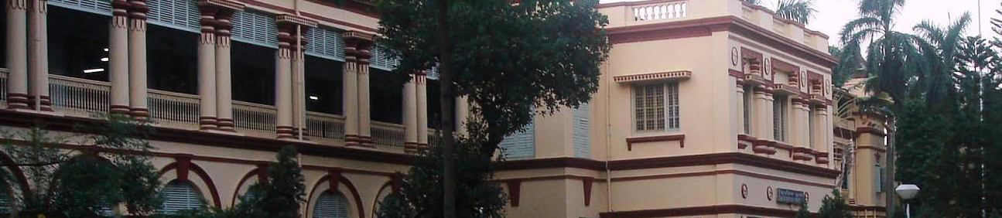

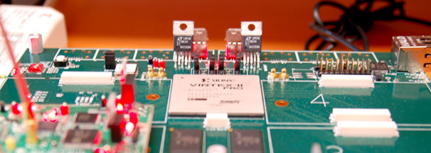
Fundamentals of the
Signals & Systems and Fourier Analysis
~ A Module on the Course of
Principles of Communication Engineering
IT/IEE/T/214
Presented by:-
Sujoy Mukherjee
Dept. of Information Technology,
Jadavpur University
E-mail : sujoymukherjee@ieee.org
Facebook Page: https://www.facebook.com/msujoy17
Webpage: http://www.Sujoy.OmKalpataru.in
January, 2011
Dept. of Electronics & Telecommunication Engineering, Jadavpur University, Kolkata, India

Slide 2
Course Outline
Introduction to Signals
Concepts of Signals and Systems (brief notes)
Introduction to Signals & Systems
Fourier Series & transform
  -Fourier Series (A detailed discussion)
  -Discussions & Expressing FS & FT in diff. forms
  -Fourier Analysis (Examples & Applications)
Fourier Transform (details)

Slide 3
Thank you ...

